Slide 1
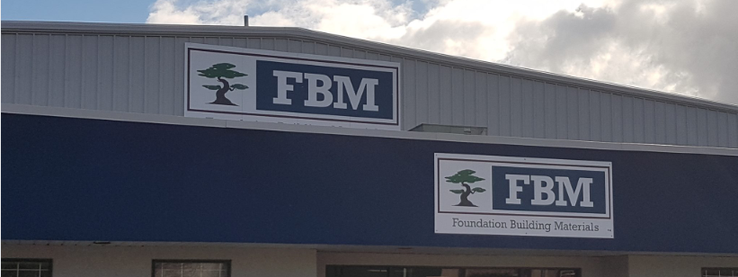

FBM PDF Invoice Process automation Case Study
July 2020

Slide 2
FBM Overview:
Foundation Building Materials (FBM®) is a leading construction materials distributor focused on exceeding the expectations of the commercial construction and residential building trades.
With over 180 locations across the United States and Canada, FBM has significant geographic reach into most major building materials markets.
FBM specializes in the local supply of building materials such as drywall, steel studs, lath, plaster, stucco, acoustical ceilings, insulation, fiberglass reinforced plastic (FRP), and exterior insulation finish systems (EIFS).
Additionally, FBM offers a wide variety of commercial-grade construction tools, drywall hand tools, fasteners, and construction supplies for residential and commercial projects.

Slide 3



Use Case:
FBM receives invoices from their vendors every month end.
There are more than 100 invoices processed by an FBM resource manually.
They are using an ERP tool APEI application for this processing.

Slide 4


AS-IS Process:
User opens every pdf invoice manually and copies information like vendor number, invoice number, amount etc.
After gathering necessary information, they will add these invoices in the APEI application manually.
For every invoices there will be multiple GL distribution list that has to be entered in APEI application which makes the process tedious and time consuming.
After entering the necessary information the user updates the invoice details in the APEI application and moves to the next invoice.

Slide 5


Business Challenge:
Since the details are sensitive , this process is highly prone to human- error.
There are multiple checks like correct GL number and the amounts entered which needs to be done for every step in the process.
This process is repetitive, rule based and time consuming for any user who does it manually.

Slide 6


Process Flow – High Level
User extracts the necessary information from invoice
User enter the details in the APEI Application.
Start
User access the pdf invoice
End
User Saves the details and closes the app

Slide 7
Process Flow – Low Level
Start
Skip invoice, add the pdf name in error data table and go to next invoice
Add the first GL number and check for type
If Type is Expense/Asset
If Bad GL no error occurs
For each pdf , Read Pdf invoice file.
For each invoice in pdf file extract relevant contents
Enter the GL information for all the invoices
Click Update GL button and continue to add GL number
Click Add GL button and continue
Login into APEI app
Continue the above process for all the invoices and PDF files.
Skip invoice, add the pdf name in error data table and go to next invoice
Press Enter and click F8 button
After completing, Send an reply email to customer attaching the error data table
If Invoice already added
Enter all the invoice details and click add invoice button.
Stop

Slide 8
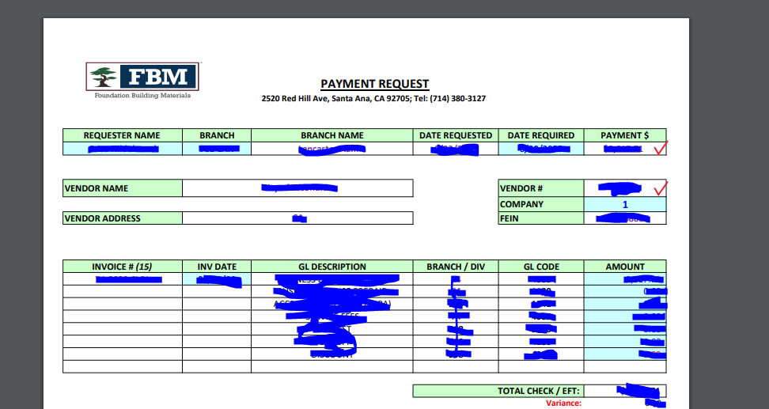
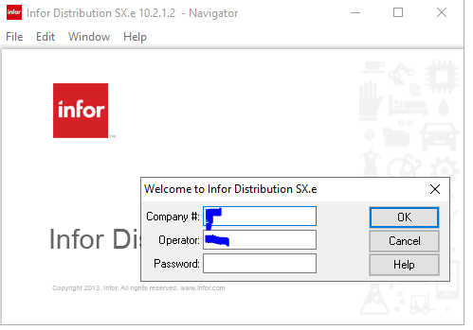
Step by Step Process:
Step 1: Bot accesses the invoice pdf file ad extracts necessary information like vendor number , amount , GL number etc. as shown in the screenshot.
Step 2: Login into APEI application with necessary credentials as shown screenshot.

Slide 9
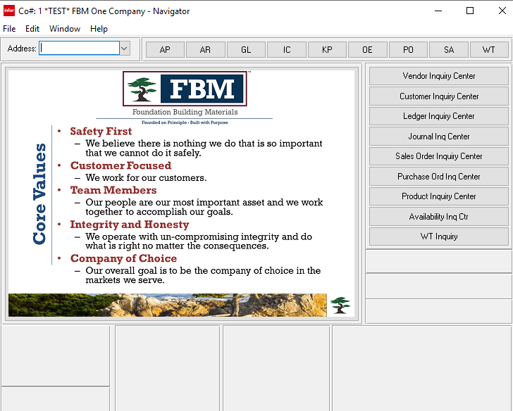
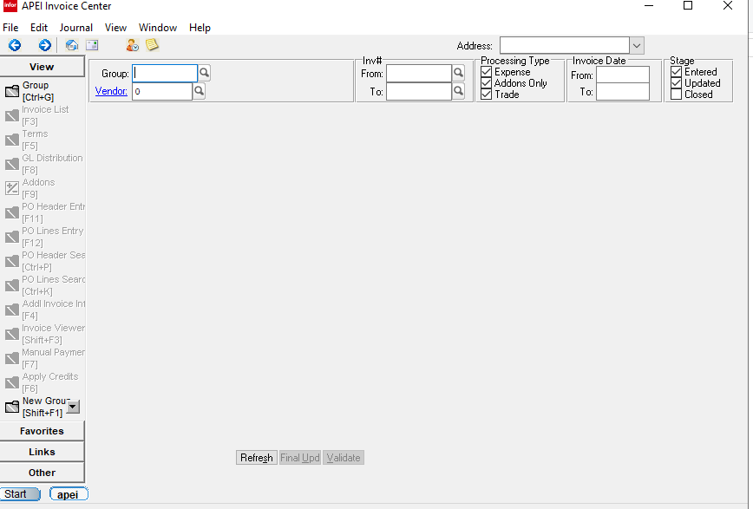
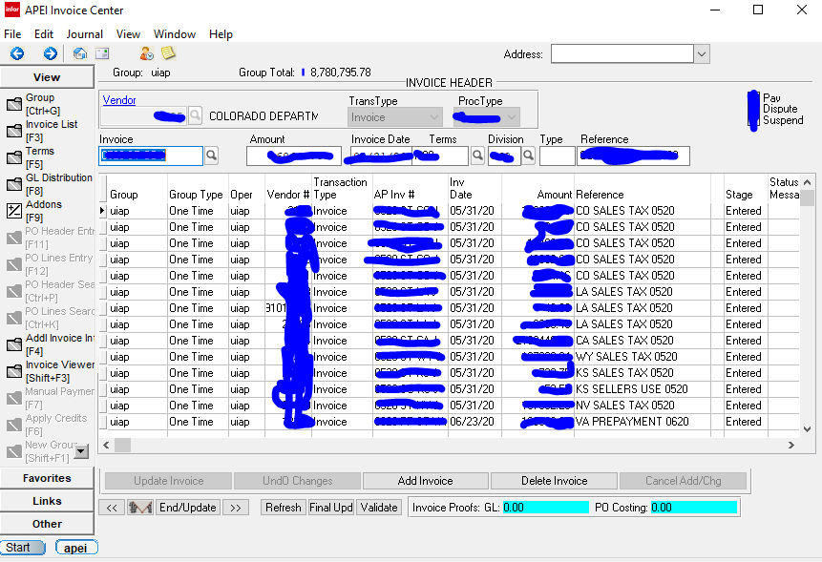
Step by Step Process:
Step 3: Type the address name in the navigator page as shown in the screenshot.
Step 4: Enter the group name in APEI invoice's center page as shown in screenshot.
Step 5: In the invoice details page, enter the details of invoice.
Step 6: Press Add invoice button and press F8 button to move to GL distribution page as show in screenshot.

Slide 10
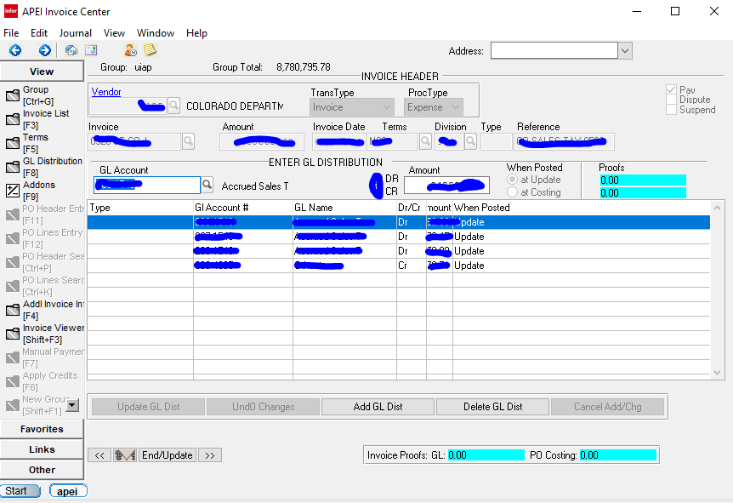
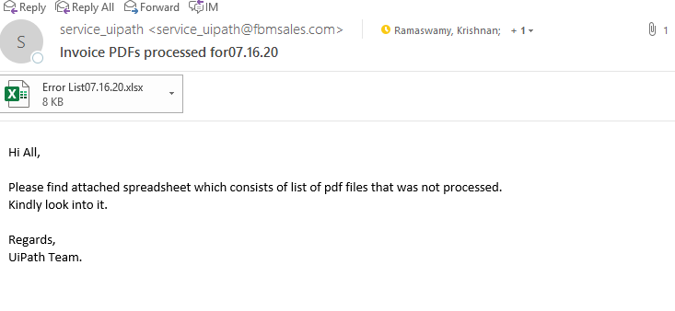
Step by Step Process:
Step 7: Enter the GL distribution details like GL number, amount etc. as shown in screenshot and check for type .
Step 8: If type is equal to Expense/Asset, Click Update GL Distribution button or Click Add GL Distribution Button.
Step 9: Repeat the above steps for each invoice in the PDF and for each GL number in each invoice.
Step 10: After the vendor number and other details are entered, the bot might show error message like “Invalid vendor” , “ vendor ID not active” and “Bad GL number” etc.
Step 11: These error messages are logged in a separate data table with invoice details.
Step 12: After processing of all the pdf invoices , the bot will send a reply email to the user with data table which contains the details of errored invoices as shown in screenshot.
Step 13: The invoices which threw an error and moved to separate folder and the invoices which are processed successfully are moved to Processed folder.

Slide 11

Challenges Faced:
The PDF format was constantly changing which made this process very difficult to automate.
The APEI application was crashing after few hours of processing which is a very big challenge.
Since this is a pdf automation, we can only rely on string manipulation techniques while extracting the details from the pdf.
The APEI application was slow while starting up and also while navigating to next pages. So we need to configure the bot accordingly.

Slide 12
Lessons Learnt:
We need to do a feasibility check before starting the automation process.
An appropriate deadline has to be given to client and we need to update the client frequently to keep them informed about our progress in development.
All the coding standards has to be followed so that we can debug the code easily if an issue comes up.
We need to get a standard operating procedure or KT session from the process owner to have a clear understanding of the process.
We need to implement appropriate error handling techniques to avoid bot crash and need to look the process from all possible angles to develop a bug free code.

Slide 13
Benefits:
Time Take with Manual effort:
For 1 Invoice = 1200 seconds (approximately)
For 100 Invoices = 120000 seconds = 2000 minutes = 33.33 hours/month (approx.)
Time taken by Robot:
For 1 invoice = 120 seconds (approximately)
For 100 invoices = 12000 seconds = 200 minutes = 3.3 hours/month (approx.)
Time saved per month for 100 invoices approximately = 30 hours
The bot can work 24/7 without any break or errors which improves quality of the work and removes time constraint.
The bot can replace the human who is doing this time-consuming tedious job which is also cost and resource saving.

Slide 14
Ongoing process:
Cost Update process for FBM vendor.
Upcoming process:
FBM has other 25 vendors for whom we need to automate cost update process.
This process is done for only one branch of FBM. FBM has total of 170 branches. Customer told us they will be identifying manual processes in other branches as well.
PDF invoice process production roll out plan:
We have completed the development and currently the process owners are testing the process.
Once they complete the testing, an separate Virtual machine will be setup by customer to which we will be moving our code.
We will trigger the bot to execute code in production VM and provide hyper care for the next 5 days.

Slide 15
Thank You

